Slide 1
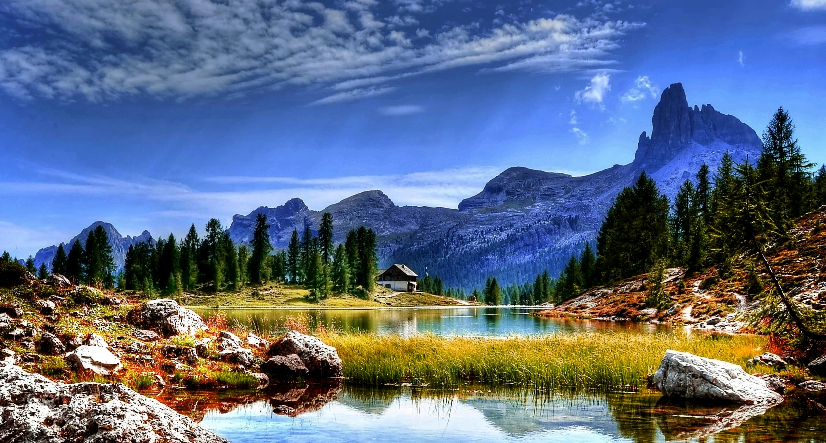
Sustainable Practices for a Greener Tomorrow
Understanding Environmental Sustainability

Slide 2
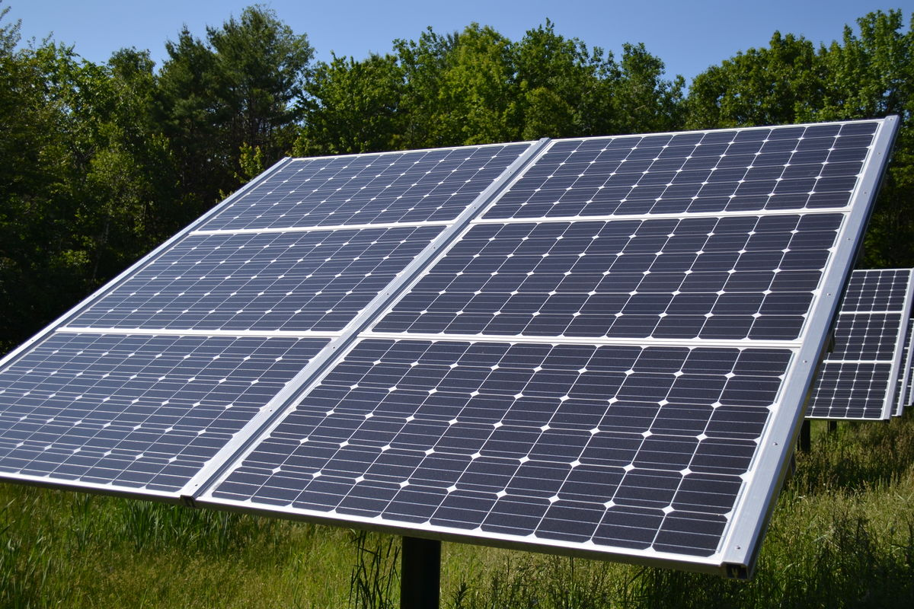
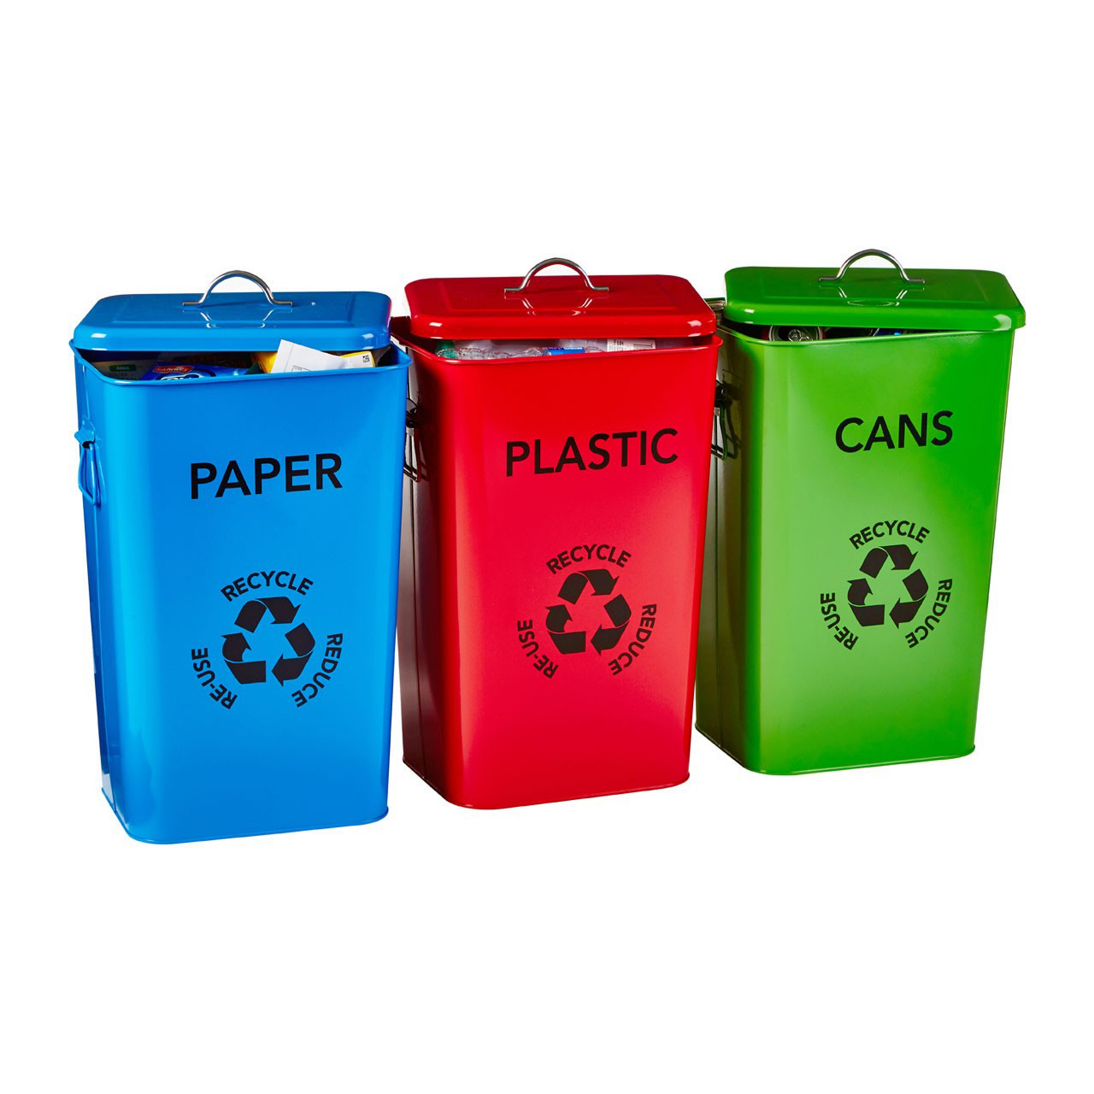
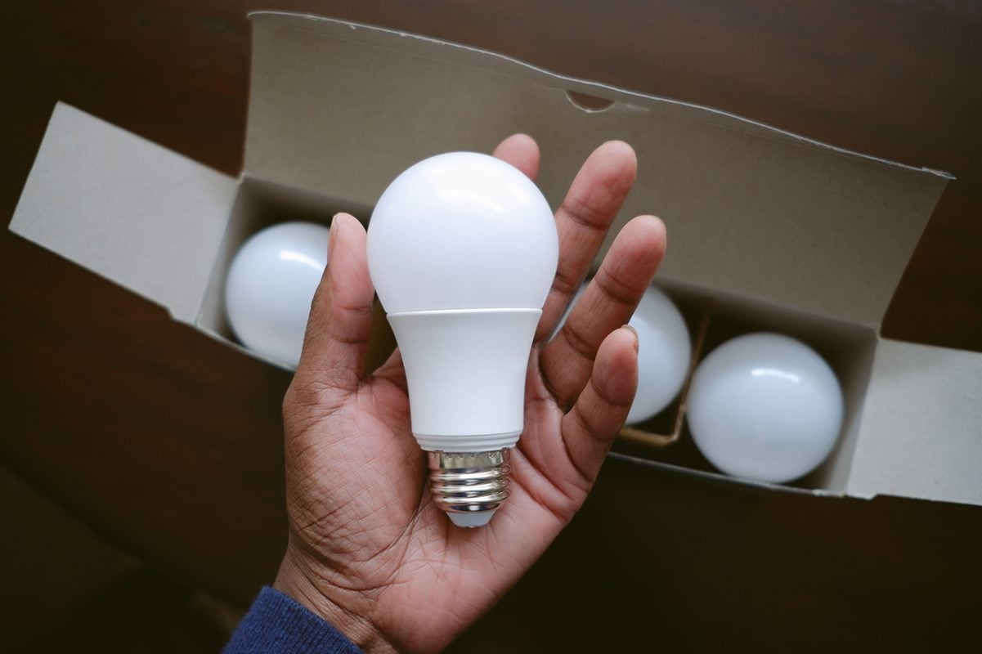
Everyday Practices to Save the Environment
Reduce, Reuse, Recycle
Switch to eco-friendly products
Save water and energy

Slide 3
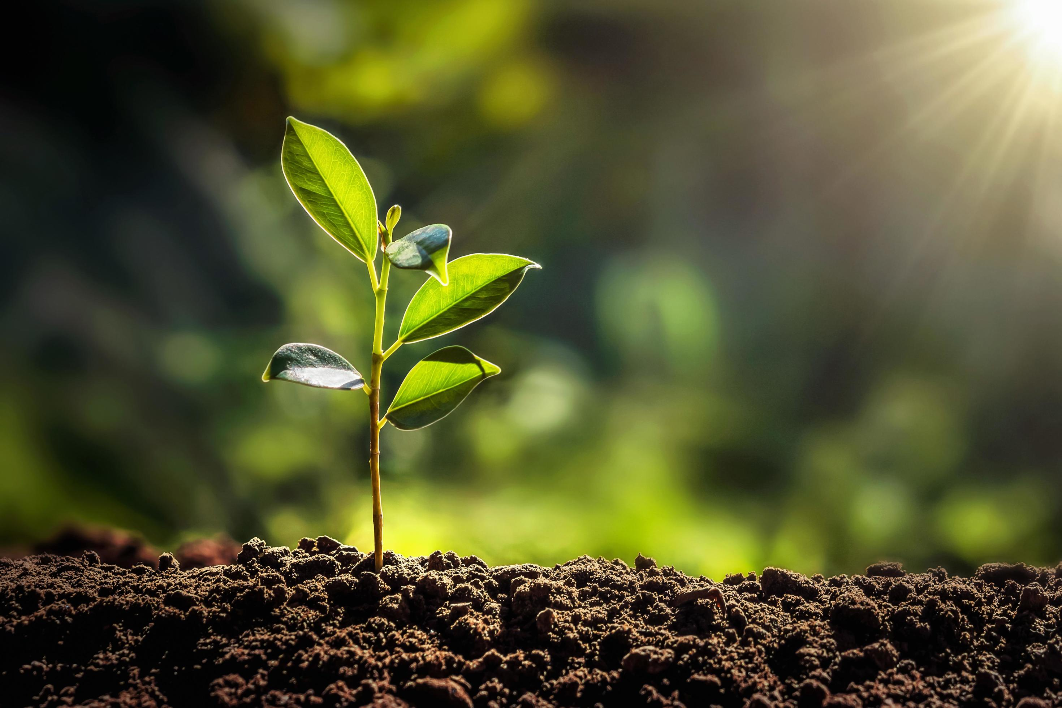
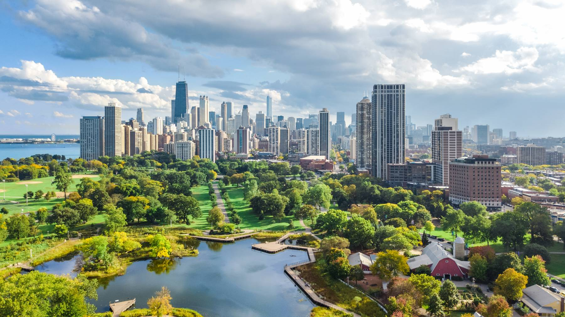
Our Greener Future

Slide 4
Let’s Save Our Environment
Trashcan

